Slide 1
Live Weather & Pollution Monitoring System
Minor Project By Akash Adhikari & Arjit Yadav

Slide 2

PROBLEM STATEMENT
Today, the winds and other weather variables are of equal concern and can have an even greater impact on our modern, high-tech lifestyle. Weather affects a wide range of man’s activities, including agriculture, transportation, and leisure time. Often the effects involve the movement of gases and particulates through the atmosphere. Now-a-days, we can monitor weather and pollution very easily. But what about specific areas where there is more pollution due to some factories or more traffic. How to get reading and get to the solution for these types of areas. We can get report of a whole city, but not for a particular area.
So, this is where the problem lies and we ought to solve it.

Slide 3

AIM
Air pollution has significant influence on the concentration of constituents in the atmosphere leading to effects like global warming and acid rains. To avoid such adverse imbalances in the nature, a live weather and air pollution monitoring system is utmost important. This project attempts to develop an effective solution for pollution monitoring using wireless sensor networks on a real time basis namely real time wireless air pollution monitoring system.

Slide 4

SCOPE
Through weather & pollution monitoring system we can collect the information about temperature & pollution level and according to current data we can produce the results in graphical manner in the system. So our main idea is to coin a system that can sense the main components that reads the weather and pollution in particular area and then we can bring a change in the surrounding according to the data and analysis.

Slide 5
INTRODUCTION
Air pollution emerged in many parts of the world as a result of explosive industrial growth. Road transport is also one of the major contributors of air pollution which contribute to climate change that has dangerous domestic and global consequences. Generation and transport of pollutant materials are governed not only by the distributions of their sources but also by the dynamics of the atmosphere. Pollutant clouds are sometimes observed traveling along the wind directions. To understand the involved processes in more detail we need more thorough data on the spreads of fine-grain pollutants and their variations with time. An air pollution & weather combined monitoring system that is comprehensive in terms of spatial and pollutant coverage and is relatively inexpensive and autonomous is the priority.

Slide 6
PROJECT METHODOLOGY
In this project we are using locally available gas sensor for observing the polluted gases like Carbon monoxide (CO) and parameters like temperature, rain, light etc. By using this method people can view the level of pollution & weather through wireless system. They can view it online on a website.
It reduced cost, reliable and comfortable for any place where we are monitoring the gases and measure the temperature and also alert for rain.
In the next slide, we will show you what we have used in this project.

Slide 7
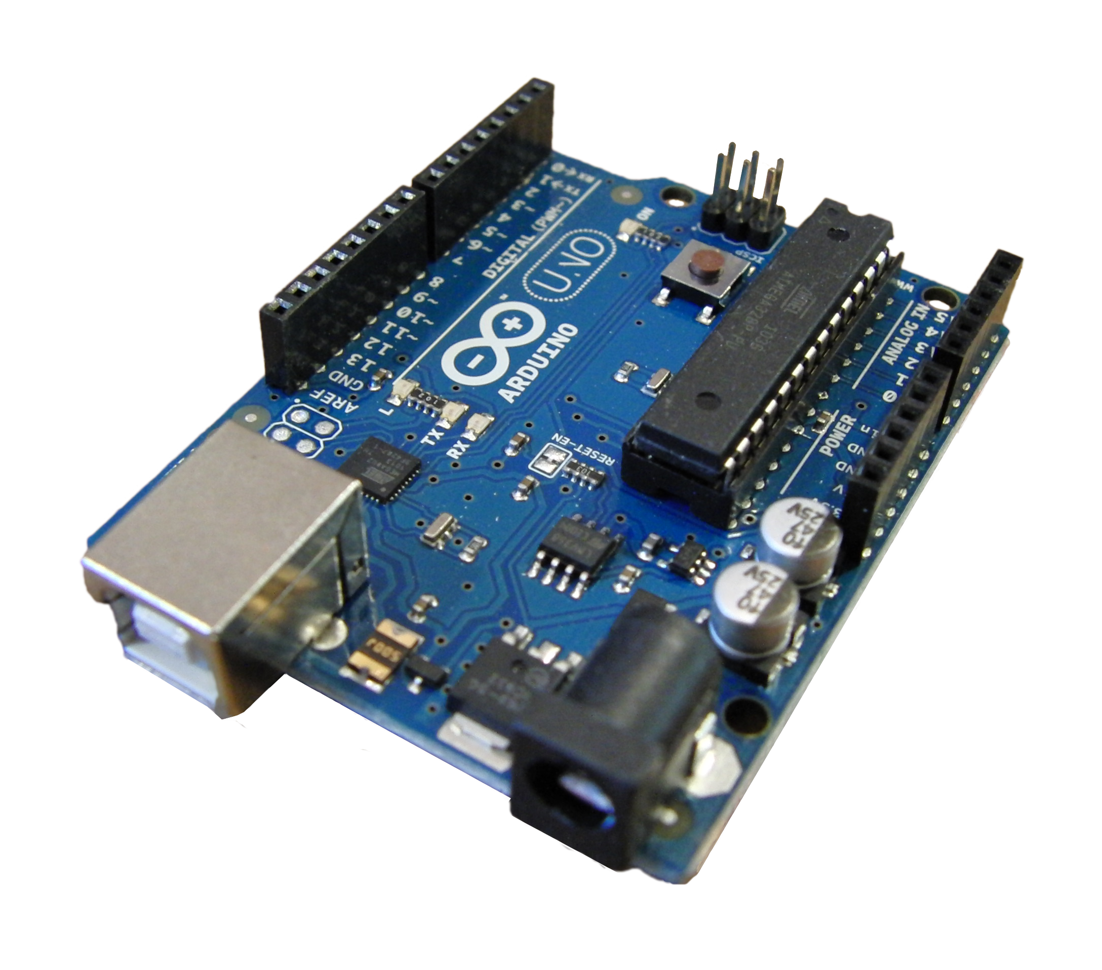
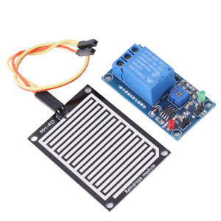
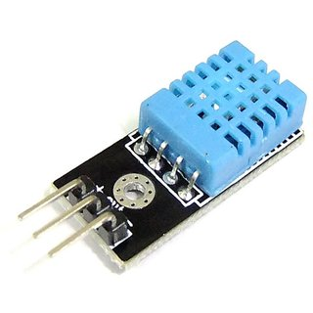
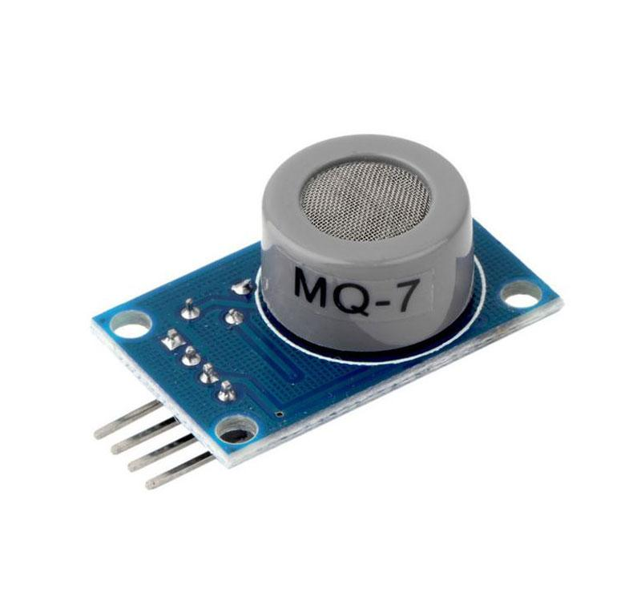



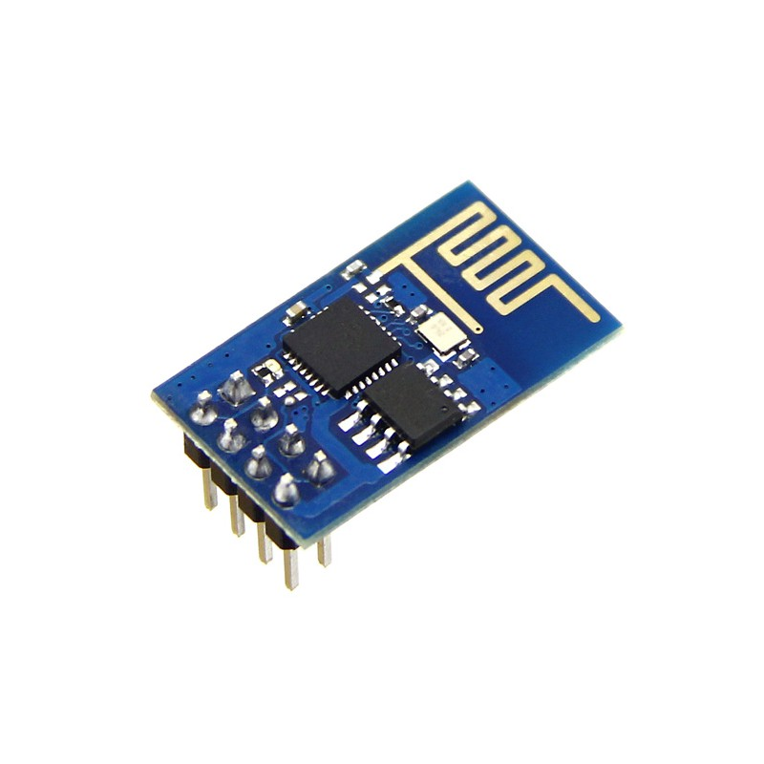
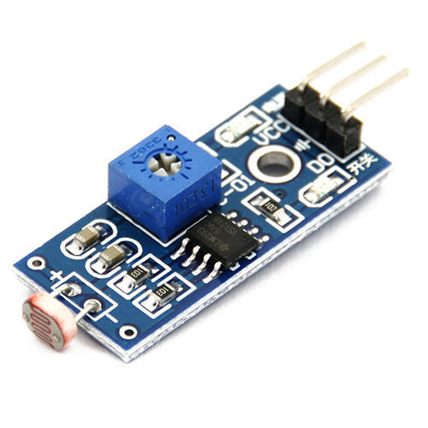


Slide 8
Platform Used
We have identified a suitable implementation model that consists of different sensor devices and other modules.In this implementation model we used Arduino UNO board with Wi-Fi module(ESP8266) which is used as embedded device for sensing and storing the data in cloud. Arduino UNO board consist of analog input pins (A0-A5), digital output pins (D0-D13), inbuilt ADC and Wi-Fi module connects the embedded device to internet. Sensors are connected to Arduino UNO board for monitoring, ADC will convert the corresponding sensor reading to its digital value and from that value the corresponding environmental parameter will be evaluated.

Slide 9
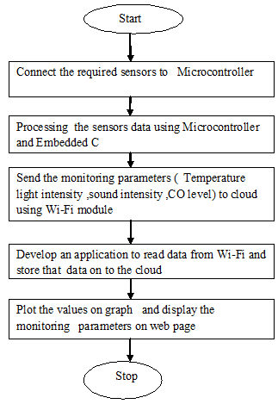
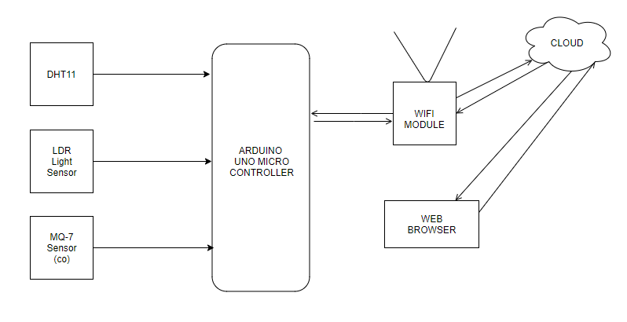
IMPLEMENTATION
Based on the framework shown, we have identified a suitable implementation model that consists of different sensor devices and other modules.
In this implementation model we used Arduino UNO board with Wi-Fi module is as embedded device for sensing and storing the data in cloud. Wi-Fi module connects the embedded device to internet.
Sensors are connected to Arduino UNO board for monitoring, ADC will convert the corresponding sensor reading to its digital value and from that value the corresponding environmental parameter will be evaluated.

Slide 10
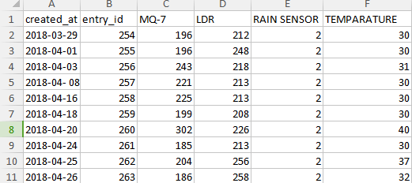
Data Set Collection

Slide 11
Results
After sensing the data from different sensor devices, which are placed in particular area of interest. The sensed data will be automatically sent to the web server, when a proper connection is established with server device.
The web server page which will allow us to monitor and control the system.
The sensed data will be stored in cloud (Google Spreadsheets & Thingspeak). The data stored in cloud can be used for the analysis of the parameter and continuous monitoring purpose.

Slide 12
Conclusion
By keeping the embedded devices in the environment for monitoring enables self protection (i.e., smart environment) to the environment.
To implement this we need to deploy the sensor devices in the environment for collecting the data and analysis.
By deploying sensor devices in the environment, we can bring the environment into real life i.e. it can interact with other objects through the network. Then the collected data and analysis results will be available to the end user through the Wi-Fi.
This project can be further expanded to monitor the developing cities and industrial zones for pollution monitoring.
To protect the public health from pollution, this model provides an efficient and low cost solution for continuous monitoring of environment.

Slide 13
Future Scope
Our system can guide farmers to plan their irrigation schedule.
Researchers/teachers can utilize the acquired weather or pollution data in their advance research or to develop better understanding in this field among the students.
It can send bad weather alerts to fishermen to plan their fishing activities.
We can take measures to stop pollution in a area where CO level is very high.
We can monitor the surrounding condition of the factory workers & alert them for any adverse conditions.

Slide 14
References
1. Satoh. F, Itakura. M, “Cloud-based Infrastructure for Managing and Analyzing Environmental Resources”, SRII Global Conference, pp.325-334, 201.
2. Kurschl. W, Beer W, “Combining cloud computing and wireless sensor networks”, International Conference on Information Integration and Web-based Applications and Services, pp.512-518, 2009.
3. Zhengtong. Y, Wenfeng. Z, “The research of environmental pollution examination system based on the Cloud Computing”,International Conference on Communication Software and Networks, pp.514-516, 2011.
4. Montgomery. K, Chiang. K, “A New Paradigm for Integrated Environmental Monitoring”, ACM International Conference Proceeding Series, 2010.
5. Wei. Q, Jin. N, Lou X, Ma. R, Xu. J, “Software design for water environment remote monitoring system based on mobile devices”, Applied Mechanics and Materials, pp. 2027-2032, 2011.

Slide 15
Project Mentor - Ms. Anubha Parashar
THE END

